Slide 1

My presentation for the 1st lesson
APOSTOLOS PROTOPSALTIS

Slide 2
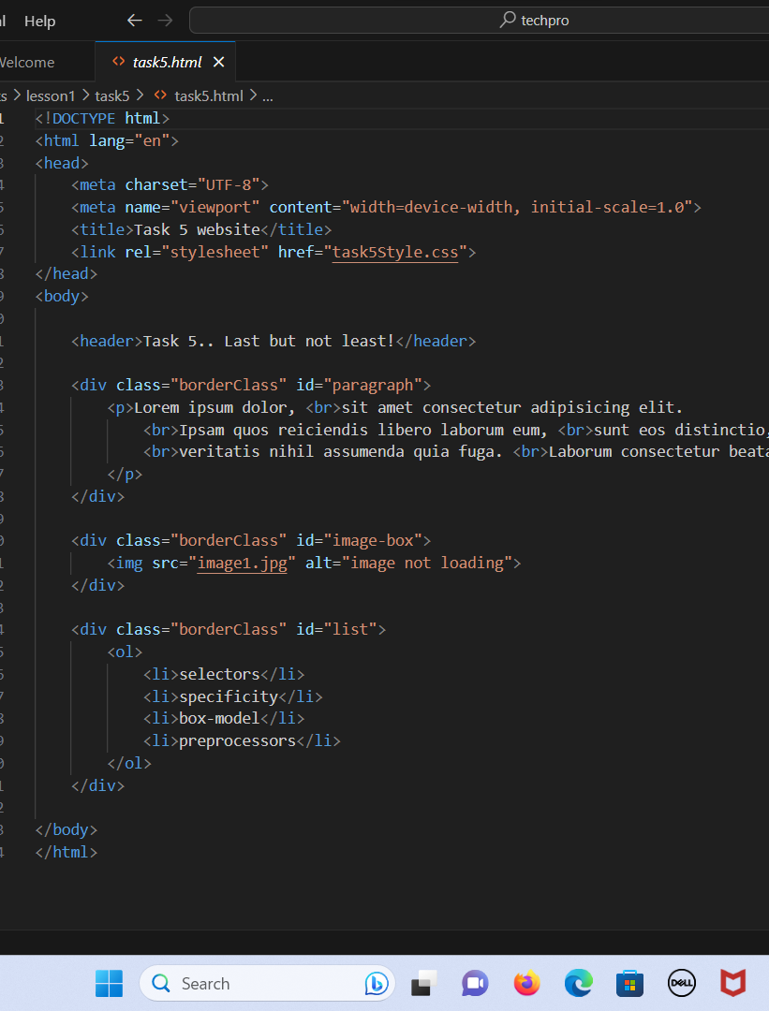
THIS IS MY HTML CODE
WE LEARTN ABOUT THE BASICS OF HTML
HTML PAGE STRUCTURE
MARKUP VALIDATOR
VS CODE

Slide 3
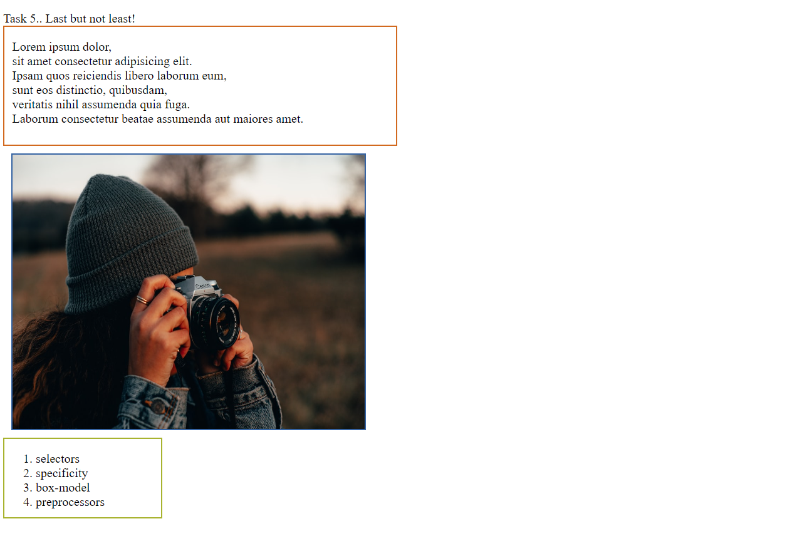
THIS IS THE OUTCOME ON THE BROWSER
A PARAGRAPH
AN IMAGE
AND A LIST
ALL WITH DIFFERENT BODRER COLOR

